Slide 1
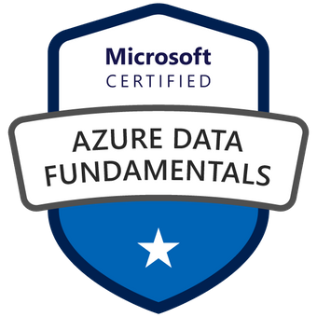

Exam DP-900: Microsoft Azure Data Fundamentals Crash Course
Tim Warner

Slide 2


Tim Warner
Based in Nashville, TN, US
Central time zone
MCT, MVP
Twitter: @TechTrainerTim
Badge: TechTrainerTim.com

Slide 3
Session 1 of 2 Agenda
Introduction
Core Data Concepts
Non-Relational Data
Relational Data (start)
Batch processing
Stream processing

Slide 4
Session 2 of 2 Agenda
Content catch-up
Relational Data (finish)
Data Analytics
Exam DP-900 strategy

Slide 5
Course Materials
timw.info/dp900

Slide 6
Course Expectations
We'll learn by doing – at least 70 percent demo
Real-world approach
Please review the recordings…several times!
10-minute break at midpoint
I’m here to answer your questions – take advantage of this
Use the Q&A panel

Slide 7

Session Recordings

Slide 8

Session Recordings

Slide 9

Session Recordings

Slide 10


Mobile Browser: learning.oreilly.com

Slide 11



O'Reilly Mobile App

Slide 12

Microsoft Certification Tiers

Slide 13
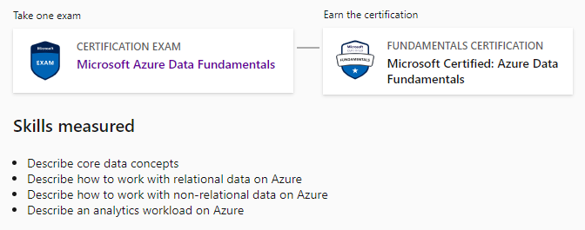
Azure Data Fundamentals
DP-900

Slide 14
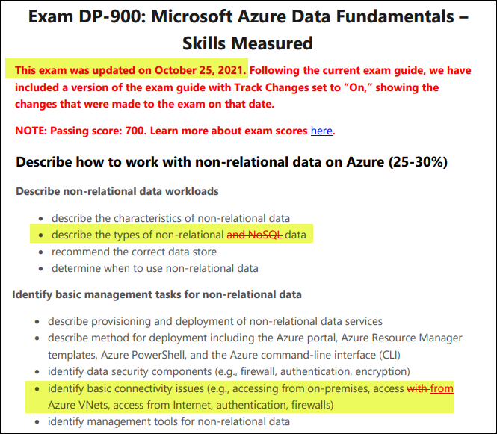
DP-900 Changes: October 25, 2021

Slide 15


Azure Data Engineer Associate
DP-203
DP-203
DP-203
Data Engineering on Microsoft Azure
Data Engineering on Microsoft Azure
1-year validity period

Slide 16
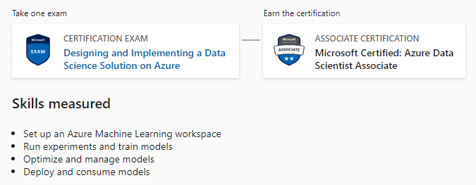
Azure Data Scientist Associate
DP-100

Slide 17
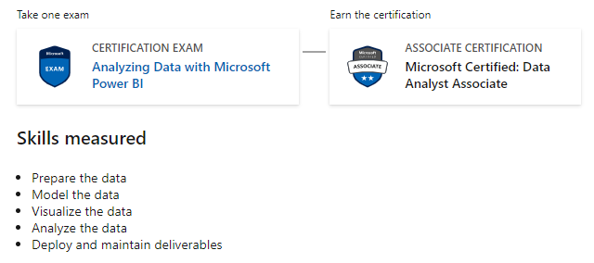
Azure Data Analyst Associate
DA-100

Slide 18
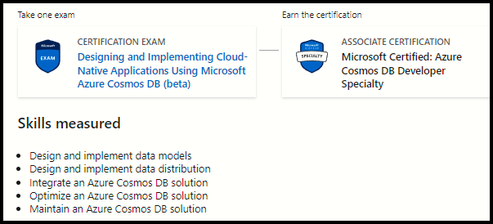
Azure Cosmos DB Developer
DP-420

Slide 19

Tim's Certification Study Model

Slide 20

Thank you!
Course materials: timw.info/dp900
Twitter: @TechTrainerTim
Work: timw.info/ps
Web: TechTrainerTim.com

Slide 21
Core Data Concepts

Slide 22
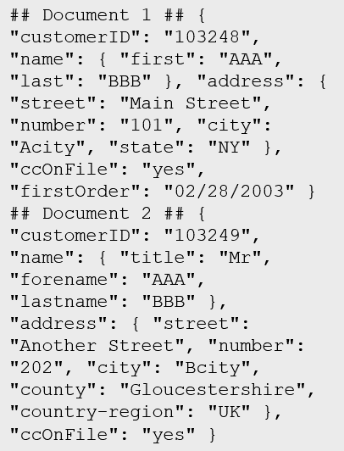
Data Types
Structured
Semi-structured
Unstructured
Table

Slide 23
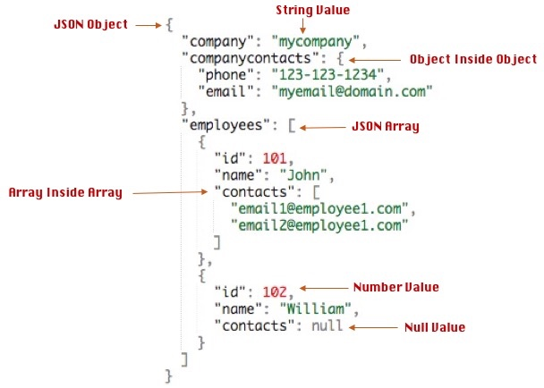
Data Formats - JSON

Slide 24

Data Workload Types
Online Transactional Processing (OLTP)
Online Analytical Processing (OLAP)
Customer
CustomerID | CustomerName | CustomerPhone
Orders
OrderID | CustomerID | OrderDate
Data is periodically loaded, aggregated and stored in a cube
Data is stored one transaction at a time

Slide 25

Data Processing Types
Batch
Streaming

Slide 26





Data Analytics
On-premises data
SQL Server, Oracle, fileshares, SAP
Data ingestion
Data storage
Data processing
Data visualization
Cloud data
Azure, AWS, GCP
SaaS data
Salesforce, Dynamics

Slide 27
Query Tools
Azure Portal
Azure Storage Explorer
Azure Data Studio
Visual Studio Code
SQL Server Management Studio
PowerShell
Azure CLI
MySQL Workbench

Slide 28
Non-Relational Data

Slide 29
Non-Relational Data Characteristics
## Customer 1 ID: 1
Name: Mark Hanson
Telephone: [ Home: 1-999-9999999, Business: 1-888-8888888, Cell: 1-777- 7777777 ]
Address: [ Home: 121 Main Street, Some City, NY, 10110,
Business: 87 Big Building, Some City, NY, 10111 ]
## Customer 2 ID: 2
Title: Mr
Name: Jeff Hay
Telephone: [ Home: 0044-1999-333333, Mobile: 0044-17545-444444 ]
Address: [ UK: 86 High Street, Some Town, A County, GL8888, UK,
US: 777 7th Street, Another City, CA, 90111 ]
Non-relational collections can have:
Multiple entities in the same collection or container with different fields
Have a different, non-tabular schema
Are often defined by labeling each field with the name it represents

Slide 30
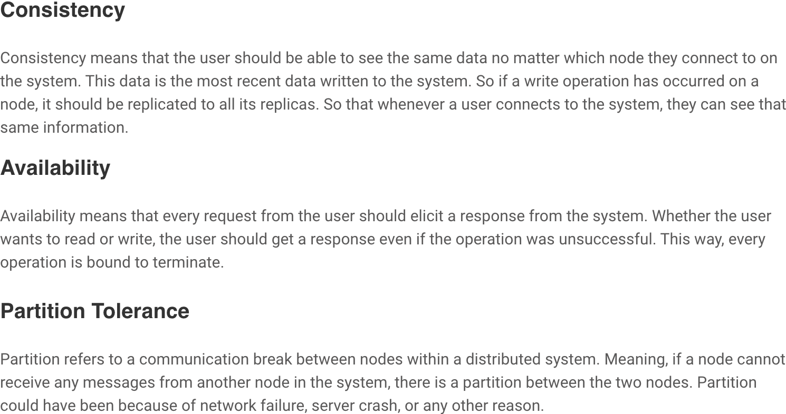
CAP Theorem

Slide 31
Azure Blob Storage
Block blobs
Page blobs
Append blobs
Has a maximum size of 4.7TB
Best for storing large, discrete, binary objects that changes infrequently
Each individual block can store up to 100MB of data
A block blob can contain up to 50000 blocks
Can hold up to 8TB of data
Is organized as a collection of fixed sized-512 byte pages
Used to implement virtual disk storage for virtual machines
The maximum size is just over 195GB
Is a block blob that is used to optimize append operations
Each individual block can store up to 4MB of data

Slide 32
Azure Table Storage
Key (Customer ID)
Value (Customer Data)
C1
AAAAA
BBB
101 Block Street
YY
999
888
C2
MM
NN
21 A Street
5 B Avenue
C3
DDD
EEE
FFF
111
222
66 C Road

Slide 33
Azure Cosmos DB
Scalability
Performance
Availability
Programming model

Slide 34
Cosmos DB APIs
SQL API
Table API
MongoDB API
Cassandra API
Gremlin API
Supports SQL-like query language
Compatible with Azure Table Storage
Compatible with MongoDB
Compatible with Cassandra
A graph database

Slide 35
Cosmos DB SQL API
COUNT( <fields_to_count> )
SUM( <numeric_fields> )
AVG( <numeric_fields> )
MAX( <numeric_fields> )
MIN( <numeric_fields> )
Aggregation Function Basics
SQL API examples
SELECT COUNT(*) FROM Products p
SELECT SUM(p.quantity) FROM Products p
WHERE p.expired = 0
SELECT AVG(p.price) AS ‘Average Price’
FROM Products p
SELECT p1.ID, p.Name, p1.Description, p1.Price FROM Products p1
WHERE p1.Price = (SELECT MIN(p2.Price) FROM Product p2)

Slide 36
Relational Data

Slide 37

Relational Database Use Cases
Identify relational database use cases
IoT:
Although typically considered for non-relational, the data from IoT devices could be structured and consistent
Online transaction processing:
For example order systems that perform many small transactional updates
Data warehousing:
Large amounts of data can be imported from multiple sources and structured to enable high-performance queries

Slide 38
Relational Database Tables
Customers
CustomerID | CustomerName | CustomerPhone
100 | Muisto Linna | XXX-XXX-XXXX
101 | Noam Maoz | XXX-XXX-XXXX
102 | Vanja Matkovic | XXX-XXX-XXXX
103 | Qamar Mounir | XXX-XXX-XXXX
104 | Zhenis Omar | XXX-XXX-XXXX
105 | Claude Paulet | XXX-XXX-XXXX
106 | Alex Pettersen | XXX-XXX-XXXX
107 | Francis Ribeiro | XXX-XXX-XXXX
Data is stored in a table
Table consists of rows and columns
All rows have same # of columns
Each column is defined by a datatype

Slide 39
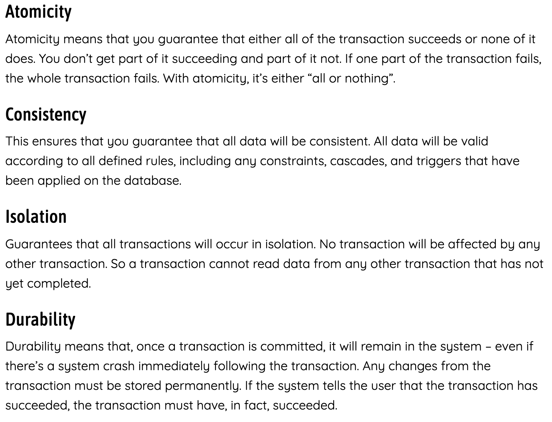
ACID Principle

Slide 40
Normalization
Customers
CustomerID | CustomerName | CustomerPhone
100 | Muisto Linna | XXX-XXX-XXXX
101 | Noam Maoz | XXX-XXX-XXXX
102 | Vanja Matkovic | XXX-XXX-XXXX
103 | Qamar Mounir | XXX-XXX-XXXX
104 | Zhenis Omar | XXX-XXX-XXXX
105 | Claude Paulet | XXX-XXX-XXXX
106 | Alex Pettersen | XXX-XXX-XXXX
Orders
OrderID | CustomerName | CustomerPhone
AD100 | Noam Maoz | XXX-XXX-XXXX
AD101 | Noam Maoz | XXX-XXX-XXXX
AD102 | Noam Maoz | XXX-XXX-XXXX
AX103 | Qamar Mounir | XXX-XXX-XXXX
AS104 | Qamar Mounir | XXX-XXX-XXXX
AR105 | Claude Paulet | XXX-XXX-XXXX
MK106 | Muisto Linna | XXX-XXX-XXXX
Data is normalized to:
Reduce storage
Avoid data duplication
Improve data quality

Slide 41

Table Relationships
Customers
CustomerID | CustomerName | CustomerPhone
100 | Muisto Linna | XXX-XXX-XXXX
101 | Noam Maoz | XXX-XXX-XXXX
102 | Vanja Matkovic | XXX-XXX-XXXX
103 | Qamar Mounir | XXX-XXX-XXXX
104 | Zhenis Omar | XXX-XXX-XXXX
105 | Claude Paulet | XXX-XXX-XXXX
106 | Alex Pettersen | XXX-XXX-XXXX
Orders
OrderID | CustomerID | SalesPersonID
AD100 | 101 | 200
AD101 | 101 | 200
AD102 | 101 | 200
AX103 | 103 | 201
AS104 | 103 | 201
AR105 | 105 | 200
MK106 | 105 | 201
In a normalized database schema:
Primary Keys and Foreign keys are used to define relationships
No data duplication exists (other than key values in 3rd Normal Form (3NF)
Data is retrieved by joining tables together in a query

Slide 42
Indexes
Customers
CustomerID | CustomerName | CustomerPhone
100 | Muisto Linna | XXX-XXX-XXXX
101 | Noam Maoz | XXX-XXX-XXXX
102 | Vanja Matkovic | XXX-XXX-XXXX
103 | Qamar Mounir | XXX-XXX-XXXX
104 | Zhenis Omar | XXX-XXX-XXXX
105 | Claude Paulet | XXX-XXX-XXXX
106 | Alex Pettersen | XXX-XXX-XXXX
IDX-CustomerRegion
CustomerID | Region
100 | France
101 | Brazil
102 | Croatia
103 | Jordan
104 | Spain
105 | France
106 | USA
An index:
Optimizes search queries for faster data retrieval
Reduces the amount of data pages that need to be read to retrieve the data in a SQL Statement
Data is retrieved by joining tables together in a query

Slide 43
Views
Customers
CustomerID | CustomerName | CustomerPhone
100 | Muisto Linna | XXX-XXX-XXXX
101 | Noam Maoz | XXX-XXX-XXXX
102 | Vanja Matkovic | XXX-XXX-XXXX
103 | Qamar Mounir | XXX-XXX-XXXX
104 | Zhenis Omar | XXX-XXX-XXXX
105 | Claude Paulet | XXX-XXX-XXXX
106 | Alex Pettersen | XXX-XXX-XXXX
Orders
OrderID | CustomerID | SalesPersonID
AD100 | 101 | 200
AD101 | 101 | 200
AD102 | 101 | 200
AX103 | 103 | 201
AS104 | 103 | 201
AR105 | 105 | 200
MK106 | 105 | 201
DB205 | 100 | 205
Create the definition of a view:
CREATE VIEW vw_customerorders AS
SELECT Customers.CustomerID, Customers.CustomerName, Orders.OrderID FROM Customers JOIN Orders on Customers.CustomerID = Orders.CustomerID
Retrieve the orders placed by customer 102 using the view:
SELECT CustomerName, OrderID from vw_customerorders WHERE CustomerID=102
A view is a virtual table based on the result set of query:
Views are created to simplify the query
Combine relational data into a single pane view

Slide 44
SQL Statement Categories
DML
DDL
DCL
Data Manipulation Language
Used to query and manipulate data
SELECT, INSERT, UPDATE, DELETE
Data Definition Language
Used to define database objects
CREATE, ALTER, DROP, RENAME
Data Control Language
Used to manage security permissions
GRANT, REVOKE, DENY

Slide 45
SQL DML Statements
Statement | Description
SELECT | Select/read from a table
INSERT | Insert new rows in a table
UPDATE | Edit/Update existing rows in a table
DELETE | Delete existing rows in a table

Slide 46
SELECT Statement
SELECT EmployeeId, YEAR(OrderDate) AS OrderYear
FROM Sales.Orders
WHERE CustomerId = 71
GROUP BY EmployeeId, YEAR(OrderDate)
HAVING COUNT(*) > 1
ORDER BY EmployeeId, OrderYear;

Slide 47
INSERT Statement
The INSERT ... VALUES statement inserts a new row
INSERT INTO Sales.OrderDetails
(orderid, productid, unitprice, qty, discount)
VALUES (10255,39,18,2,0.05);
Table and row constructors add multirow capability to INSERT ... VALUES
INSERT INTO Sales.OrderDetails
(orderid, productid, unitprice, qty, discount)
VALUES
(10256,39,18,2,0.05),
(10258,39,18,5,0.10);

Slide 48
SQL DML Statements
Statement | Description
CREATE | Create a new object in the database, such as a table or a view
ALTER | Modify the structure of an object. For instance, altering a table to add a new column.
DROP | Remove an object from the database.
RENAME | Rename an existing object.

Slide 49
CREATE Statement
CREATE TABLE Mytable
(Mycolumn1 int NOT NULL PRIMARY KEY, Mycolumn2 VARCHAR(50) NOT NULL , Mycolumn2 VARCHAR(10) NOT NULL

Slide 50
Data Analytics

Slide 51
Data Processing

Slide 52
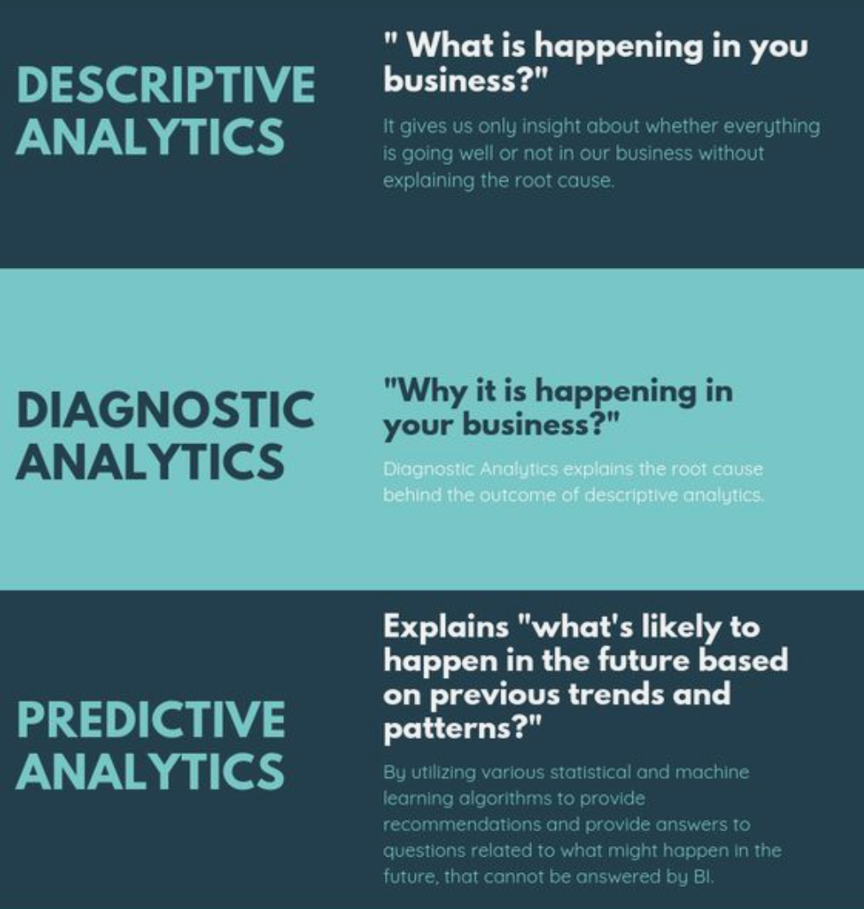
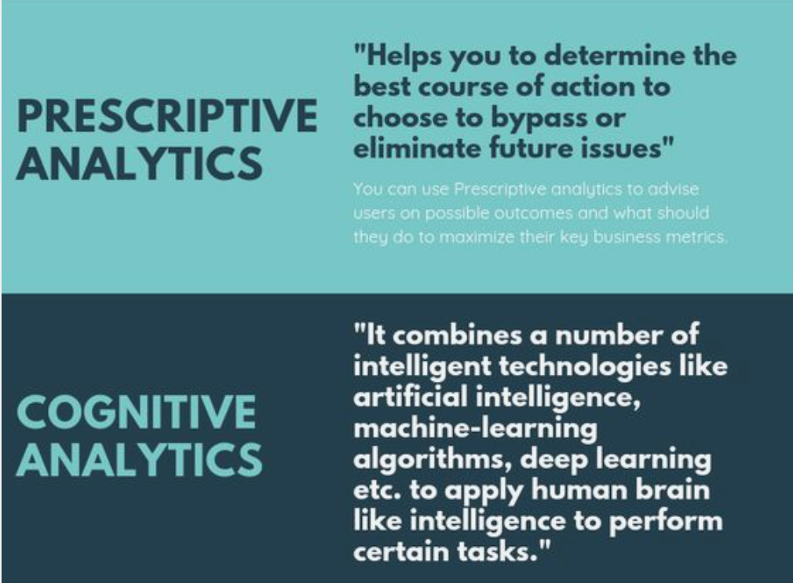
Data Analytics - Types

Slide 53

Data Lake

Slide 54
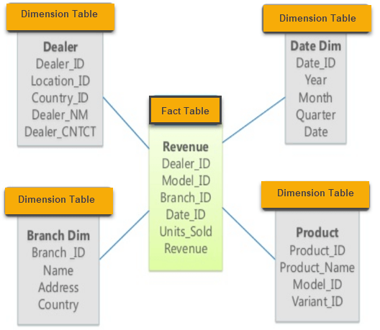
Data Warehouse Star Schema

Slide 55
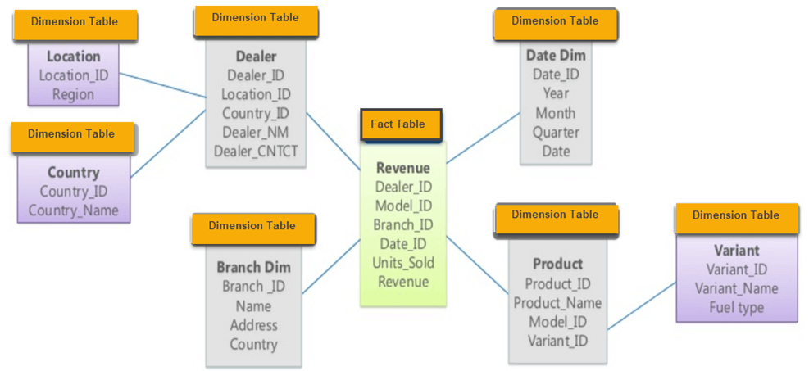
Data Warehouse Snowflake Schema

Slide 56
ETL
Azure Data Factory
Azure Stream Analytics

Slide 57
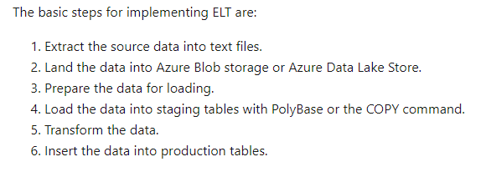
ELT

Slide 58
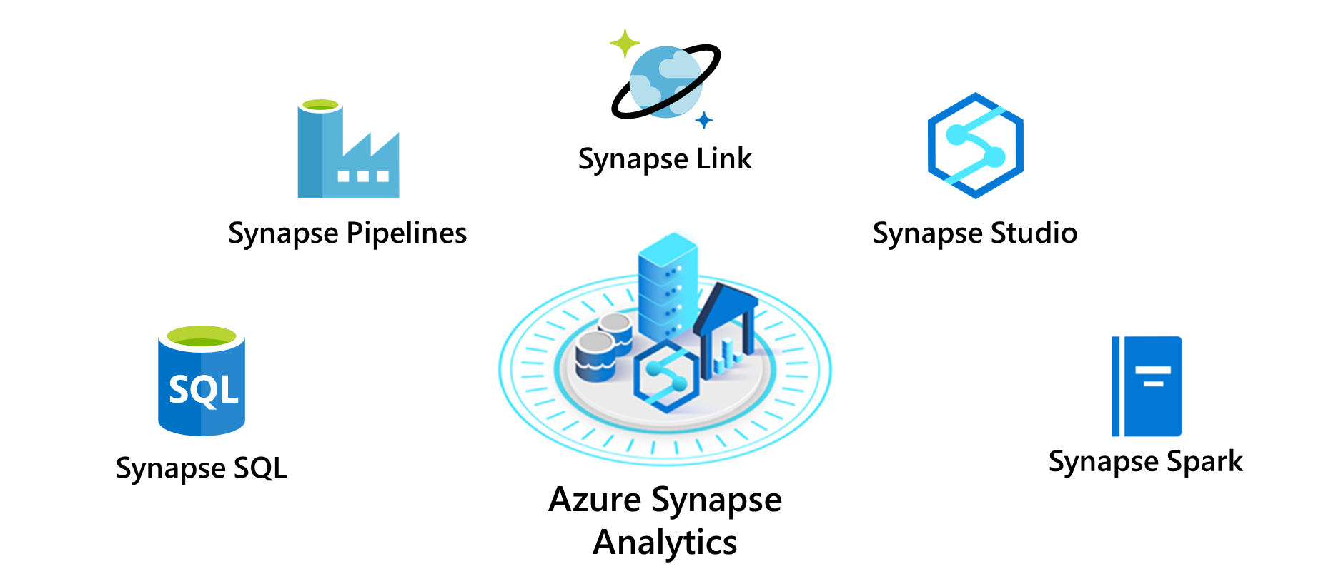
Azure Synapse
PolyBase

Slide 59
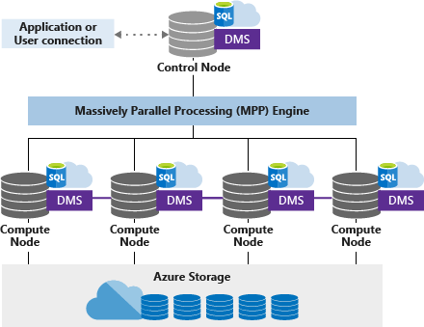
Azure Synapse SQL Pool

Slide 60

ADLS Gen 2
A repository of data for your Modern Data Warehouse
Organises data into directories for improved file access
Supports POSIX and RBAC permissions
It is compatible with Hadoop Distributed File System
Store
Azure Data Lake Storage
High performance data lake available in all 54 Azure regions

Slide 61
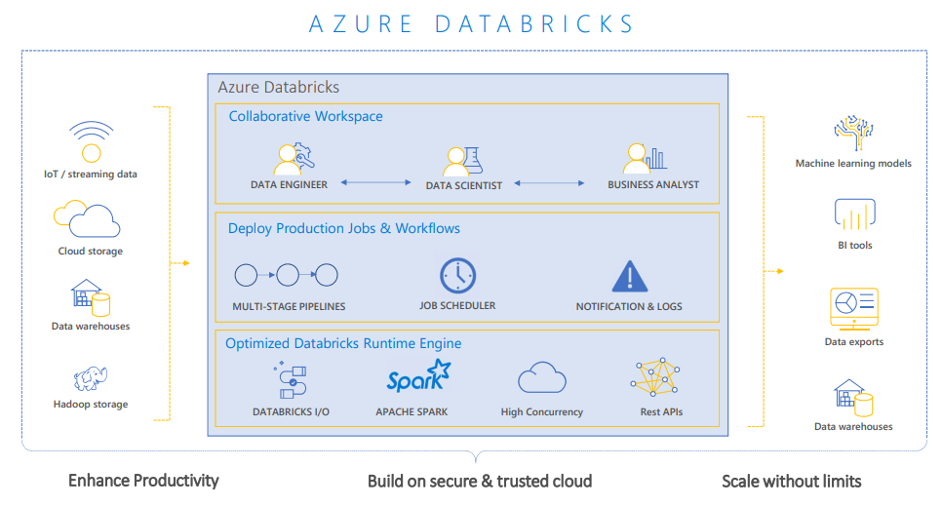
Azure Databricks

Slide 62

Azure Data Factory

Slide 63
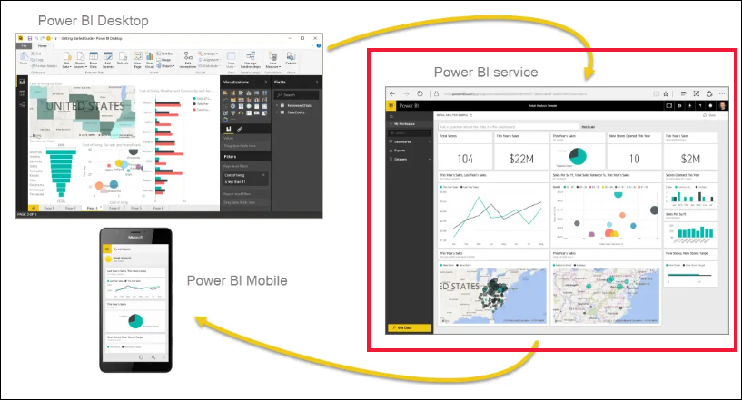
Power BI

Slide 64
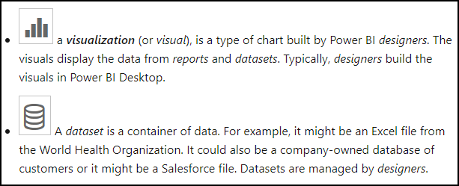
Power BI Terminology

Slide 65
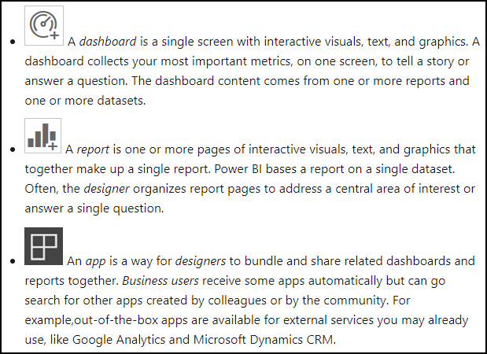
Power BI Terminology

Slide 66
Exam DP-900 Item Types

Slide 67

Multiple Choice

Slide 68
Repeated Scenario
You need to move an Azure VM to another hardware host.
Solution: You redeploy the VM.
Does this solution meet the goal?
Yes
No

Slide 69

Select and Place

Slide 70

Active Screen/Fill in the Blank

Slide 71
Microsoft Online Testing

Slide 72
Microsoft Online Testing Process
timw.info/online

Slide 73

Microsoft Online Testing Process

Slide 74

Microsoft Online Testing Process

Slide 75

Microsoft Online Testing Process

Slide 76

Microsoft Online Testing Process

Slide 77

Microsoft Online Testing Process

Slide 78

Microsoft Online Testing Process

Slide 79

Microsoft Online Testing Process

Slide 80
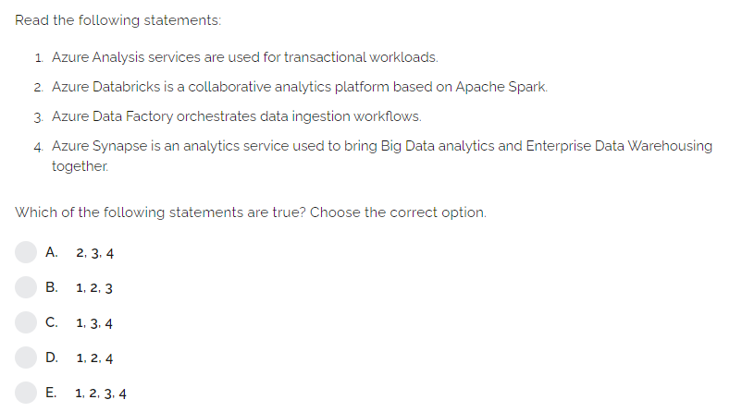

Slide 81
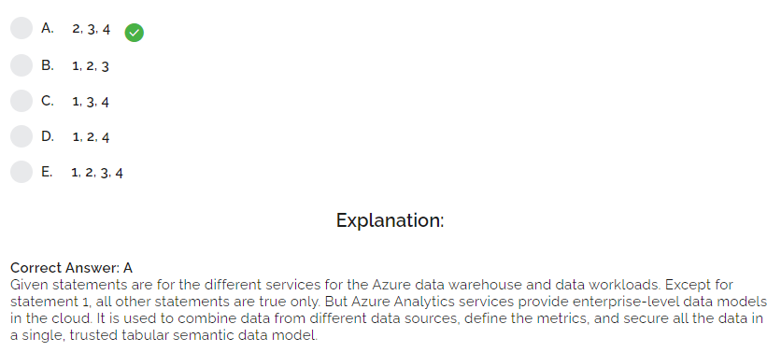

Slide 82
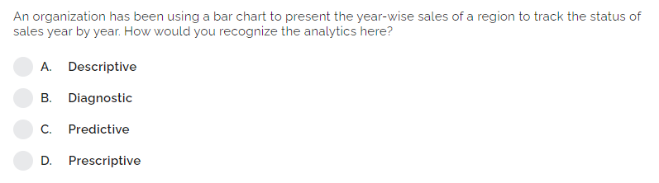

Slide 83
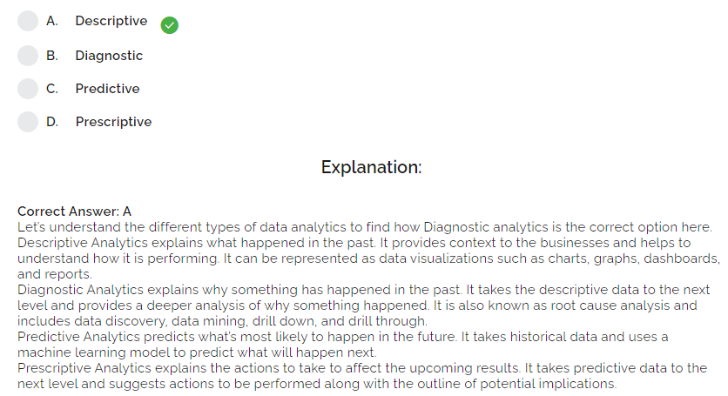

Slide 84
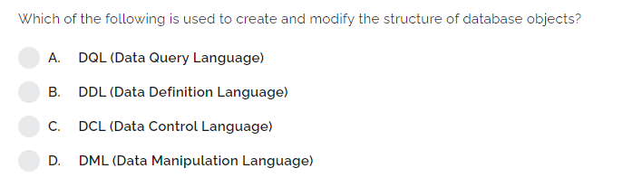

Slide 85
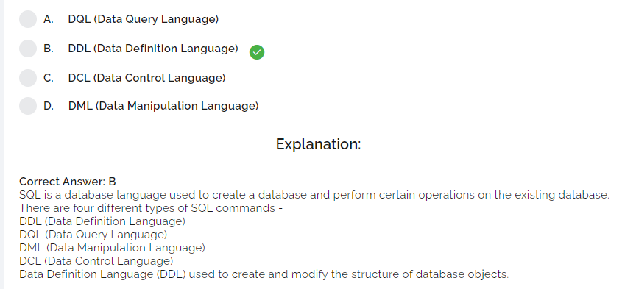

Slide 86
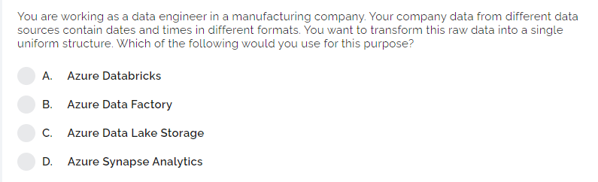

Slide 87
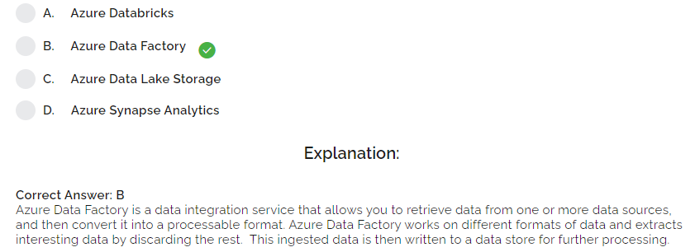

Slide 88
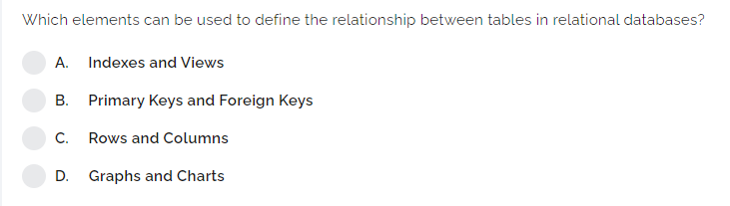

Slide 89
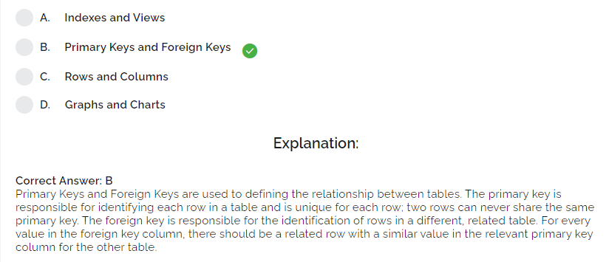

Slide 90
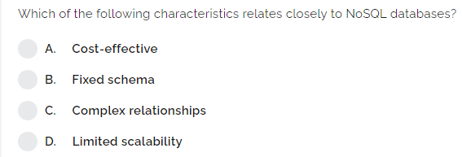

Slide 91
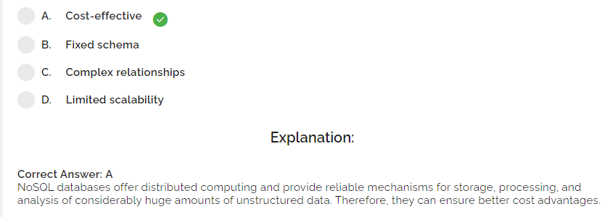

Slide 92
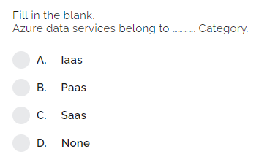

Slide 93
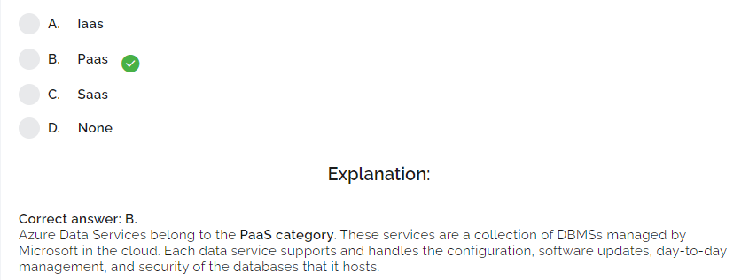

Slide 94
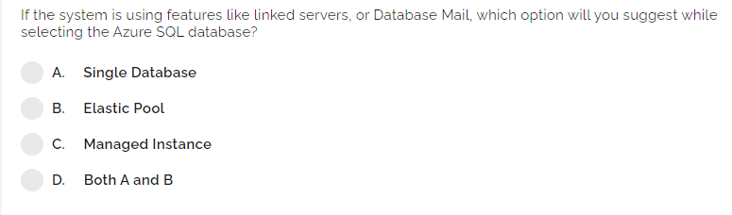

Slide 95
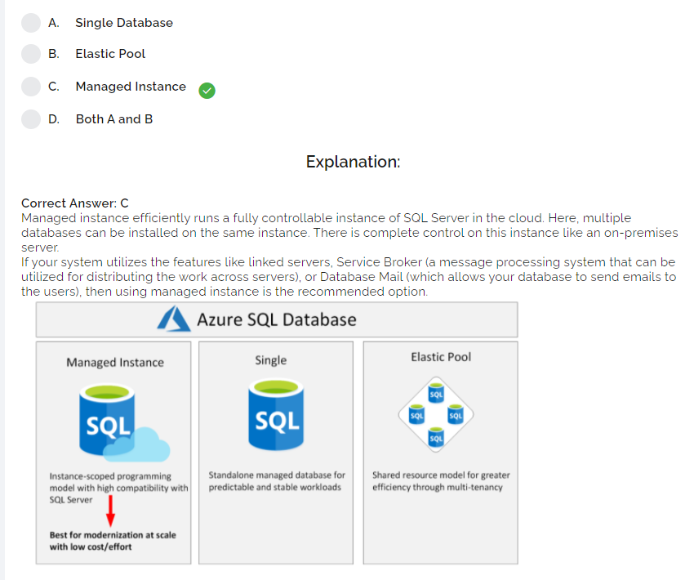

Slide 96
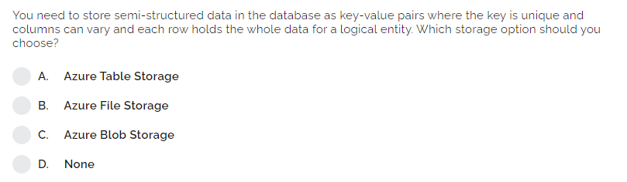

Slide 97
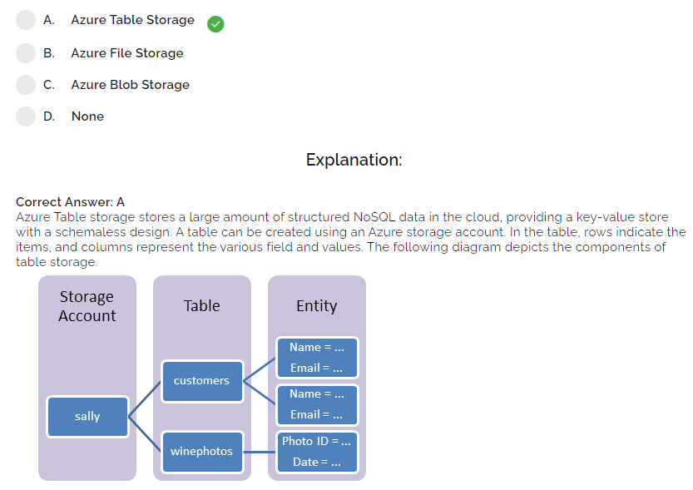

Slide 98
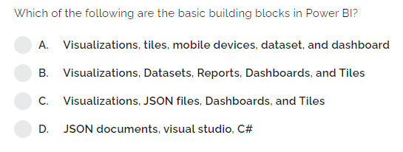

Slide 99
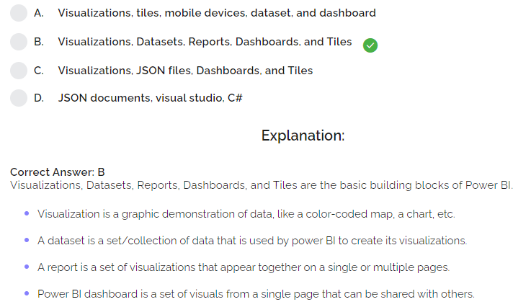

Slide 100
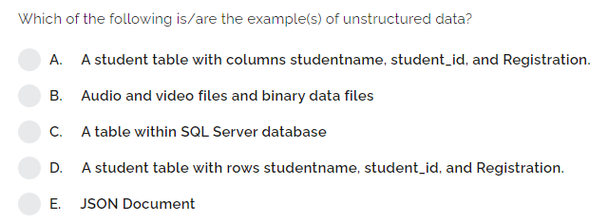

Slide 101
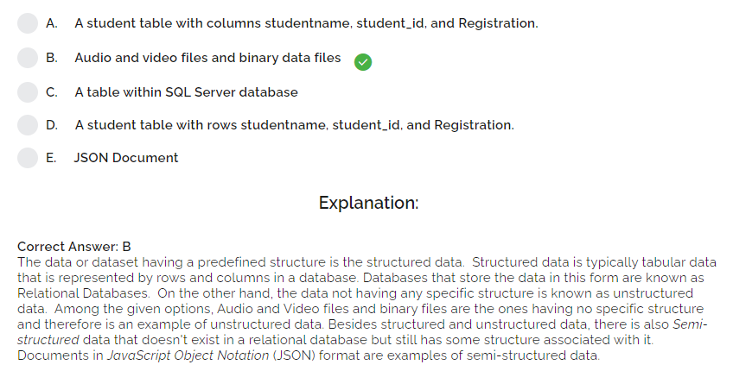

Slide 102
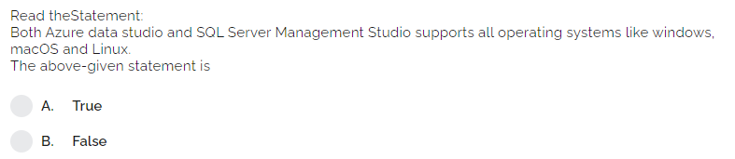

Slide 103
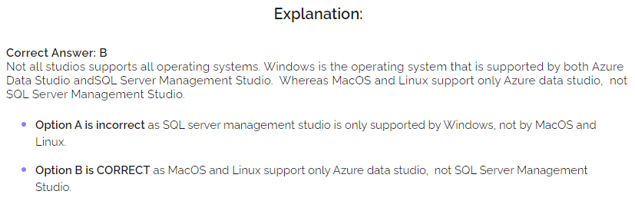

Slide 104
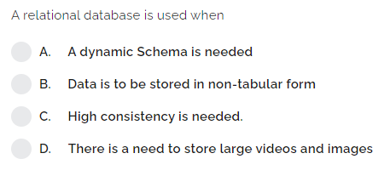

Slide 105
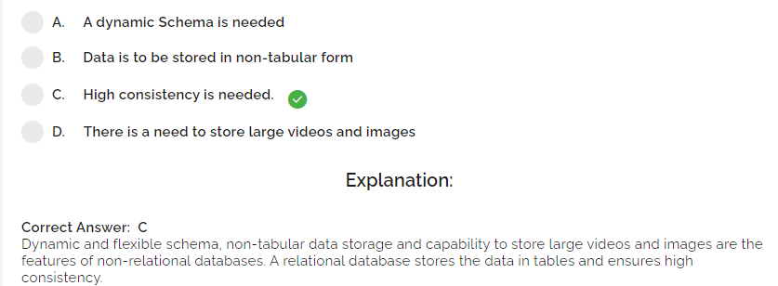

Slide 106
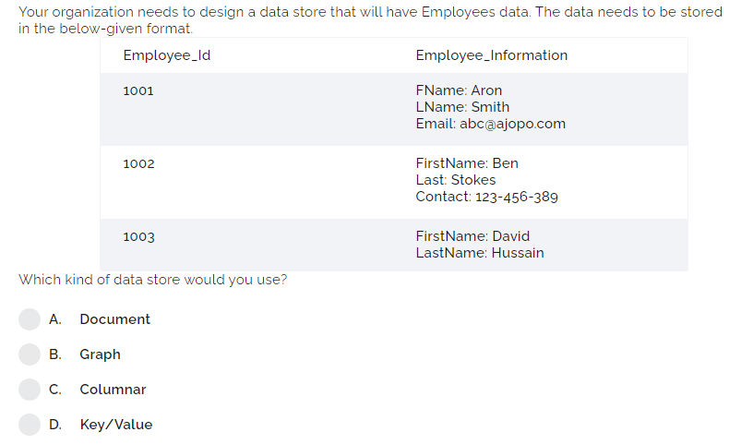

Slide 107
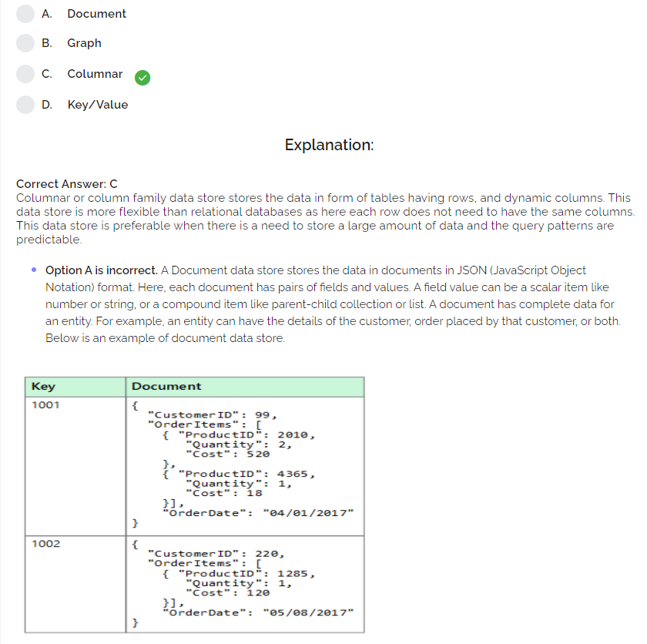

Slide 108
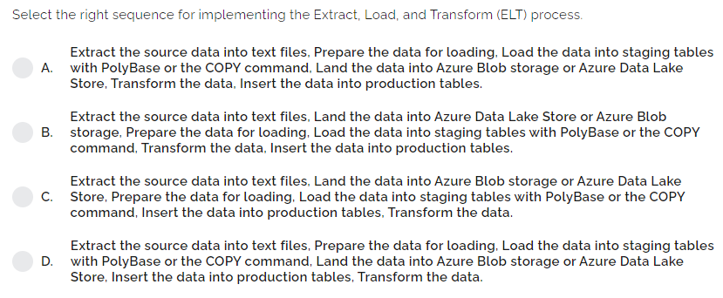

Slide 109


